Slide 1
Introduction to Programming in Python
Ezekiel Adebayo Ogundepo (@gbganalyst)

Slide 2
Data type and variable assignment

Slide 3
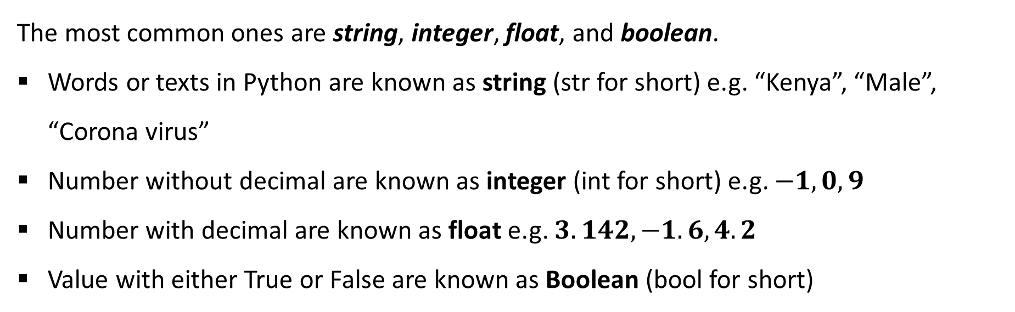
Data Types in Python
The most common ones are string, integer, float, and boolean.
Words or texts in Python are known as string (str for short) e.g. “Kenya”, “Male”, “Corona virus”
Number without decimal are known as integer (int for short) e.g. $−1, 0, 9$
Number with decimal are known as float e.g. $3.142,−1.6, 4.2$
Value with either True or False are known as Boolean (bool for short)

Slide 4
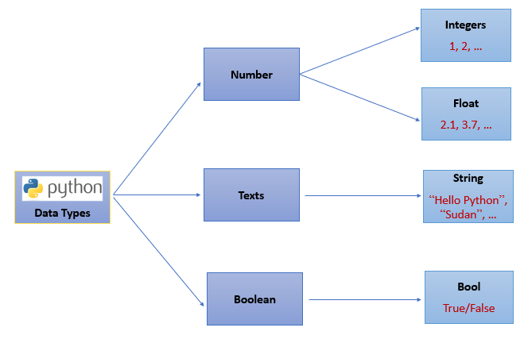
Data types
Python can tell you the data type by using type() function. Python refers integer number as int, float as float, character or text as str and boolean as bool.

Slide 5
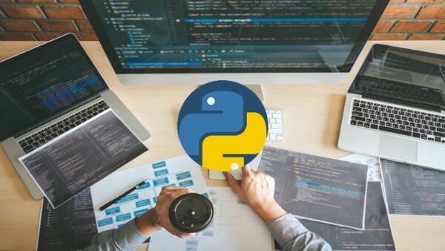
Lab session

